Slide 1

PANIMALAR ENGINEERING COLLEGE
Department of Computer Science and Engineering
CS8811 PROJECT WORK
BRAIN STROKE PREDICTION BY USING CLASSIFICATION TECHNIQUE
Team Members with Register Number
Project Guide -
Vijayalakshmi.P
SRIVAS C – 211419104269
B HARSHA VARDHAN - 211419104096
YUVA PRAKASH M - 211419104315
Batch Number -
C12

Slide 2
INTRODUCTION
Stroke occurs when the blood flow to various areas of the brain is
disrupted or diminished, resulting in the cells in those areas of the brain
not receiving the nutrients and oxygen they require and dying.
The World Health Organization (WHO) estimates
that fifteen million people worldwide suffer from strokes each year, with
one person dying every four to five minutes in the affected population.
Stroke is India’s fourth leading cause of death.
With the development of technology in the medical sector, it is now possible to
anticipate the onset of a stroke by utilizing ML techniques.
The main motivation of this paper is to demonstrate how ML
may be used to forecast the onset of a brain stroke.

Slide 3
LITERATURE SURVEY
Author | Year | Title | Source | Findings
DR. AMOL K. KADAM , PRIYANKA AGARWAL | 2022 | Brain Stroke Prediction Using Machine Learning Approach | Iconic Research And Engineering Journals | The AI models are worked to foresee the chance of cerebrum stroke.
Mrs. Neha Saxena, Mr. Deep Singh Bhamra, Mr. Arvind Choudhary | 2014 | Brain Stroke Prediction using Machine Learning | International Journal of Emerging Technologies and Innovative Research | Stroke is the 2nd leading cause of death globally, responsible to approximately 11% of total deaths . For survival prediction, ML model uses dataset to predict whether a patient is likely to get stroke based on the input parameters like gender, age, various diseases, and smoking status.
Manisha Sanjay Sirsat, Eduardo Ferme , and Joana Camara | 2020 | Machine Learning for Brain Stroke: A Review | Journal of Stroke and Cerebrovascular Diseases | A total of 39 studies were identified from the results of ScienceDirect web scientific database on ML for brain stroke from the year 2007 to 2019.
SERGIO PEÑAFIEL, NELSON BALOIAN, HORACIO SANSON, AND JOSÉ A. PINO | 2021 | Predicting Stroke Risk With an Interpretable Classifier | Journal of the American Medical Informatics Association | Presents experiments comparing the results of the Dempster-Shafer method with the ones obtained using other well-known machine learning methods like Multilayer perceptron, Support Vector Machines and Naive Bayes.
Douglas Teoh | 2014 | Towards stroke prediction using electronic health records | Annual International Conference of the IEEE Engineering in Medicine and Biology Society | The best neural network incorporated and combined the different sources of temporal data through a dual-input topology.

Slide 4
PROBLEM STATEMENT
Stroke is the second leading cause of death worldwide and remains an
important health burden both for the individuals and for the national
healthcare systems.
Therefore, the goal of our project is to apply principles of machine learning
over large existing data sets to effectively predict the stroke based on
potentially modifiable risk factors.
This project is developed to provide a personalized warning to each user on
the basis of each user's level of stroke risk.

Slide 5
TECHNOLOGY STACK
SOFTWARE REQUIREMENTS
Operating System : Windows
Tool : Anaconda with Jupyter Notebook
HARDWARE REQUIREMENTS
Processor : Pentium IV/III
Hard disk : minimum 80 GB
RAM : minimum 2 GB

Slide 6
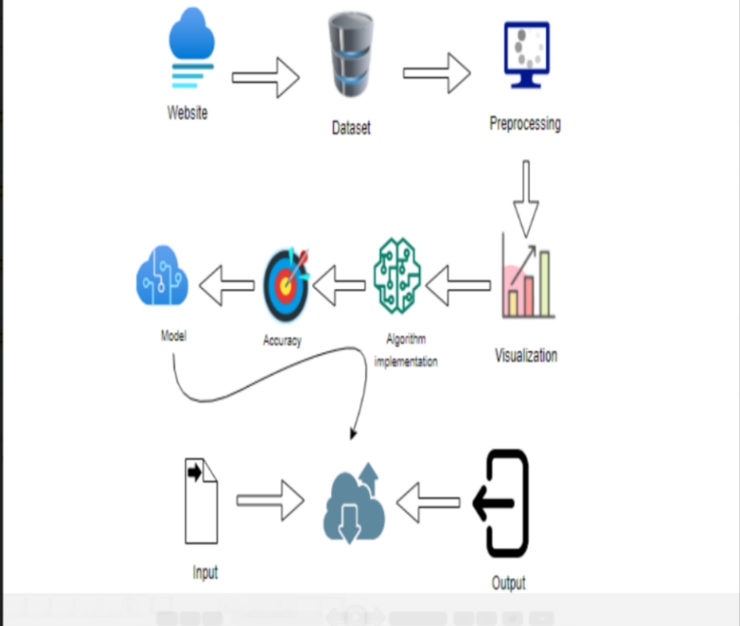
SYSTEM ARCHITECTURE

Slide 7
SYSTEM DESIGN
1. FLOW CHART
Source data
Data pre-processing and cleaning
Training dataset
Testing dataset
Classification ML algorithms
Best model by accuracy
Finding brain stroke

Slide 8
2. DATAFLOW DIAGRAM
Start
Dataset for brain stroke prediction
Data cleaning
Cleaned data
Data visualisation
Visualised data
Applying ML algorithms
Applying data mining method
Predicts whether brain stroke will occur or not
End

Slide 9
3. ENTITY RELATIONSHIP DIAGRAM
Brain Stroke Dataset
MLP
Naïve Bayes
Tuning
algorithms
Decision tree
Machine Learning
SVM
Input data
Model
Output

Slide 10
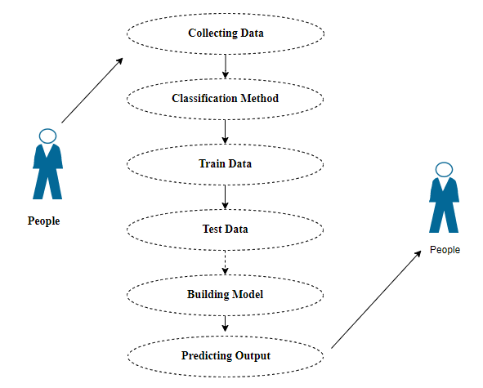
4. USE CASE DIAGRAM

Slide 11
4. SEQUENCE DIAGRAM
Dataset
Past data
Tuning model
Predicting brain stroke
People
Report of data
Its valid
Verified valid data
Brain stroke prediction
Reports details by ML method

Slide 12
MODULE DESCRIPTION: Module -1 Data Pre-processing:
This is the very first module in this project.
In this module, we will do data pre processing as the raw dataset might contain
many missing data, duplicate data, null values, unwanted data, imbalanced
data etc.
In this module, we are importing pandas and numpy packages for reading the
dataset and for performing various mathematical operations respectively.
We are using methods like duplicated(), dropna(), unique() etc for data cleaning.

Slide 13
Module - 2
Data visualisation
In this module, we will make diagrammatic representation of the dataset in
order to understand it more clearly and effectively.
These two modules are the basic modules which are necessary for every
project.
Other than pandas and numpy packages, we are also importing
matplotlib.pyplot and seaborn packages which helps to convert the large
dataset into various diagrams.

Slide 14
Module - 3
Implementing the Naivebaiyes classifier algorithm
This is the module where we start implementing various ML algorithms and
checks each algorithms accuracy.
In our dataset there are many columns which contains objects(English
words) which a computer cant understand. So from the sklearn library we
are importing LabelEncoder method which converts the words into
numbers making the computer understand the dataset more efficiently.
We will divide the whole dataset into 2 parts one the input part stored in x
variable and the other the output stored in y variable and will train both of
them and will check the accuracy of the algorithm.

Slide 15
Module 4,5,6
Implementing Decision tree, MLP and SVM classifier algorithms
In these 3 modules we will be implementing Decision tree classifier, MLP
classifier and Support vector machine respectively and will check the
accuracy of each.
We are using the confusion matrix method to find the performance of the
algorithm.
We are also using classification report method which gives us some of the
important values such as the Precision, recall, f1-score and support ect.
Finally after calculating the performance of each implemented algorithm
we will finalize the algorithm which has the best accuracy.

Slide 16
Performance Analysis
In this project we implemented 4 algorithms and found out each of its
accuracy.
Also we used the confusion matrix to find the performance of the algorithm.
After analysing the performance of each algorithm we saw that the
decision tree classifier algorithm gave the best accuracy of 96% compared
with other ML algorithms.
Hence, in this project we used decision tree classifier algorithm for brain
stroke prediction.

Slide 17
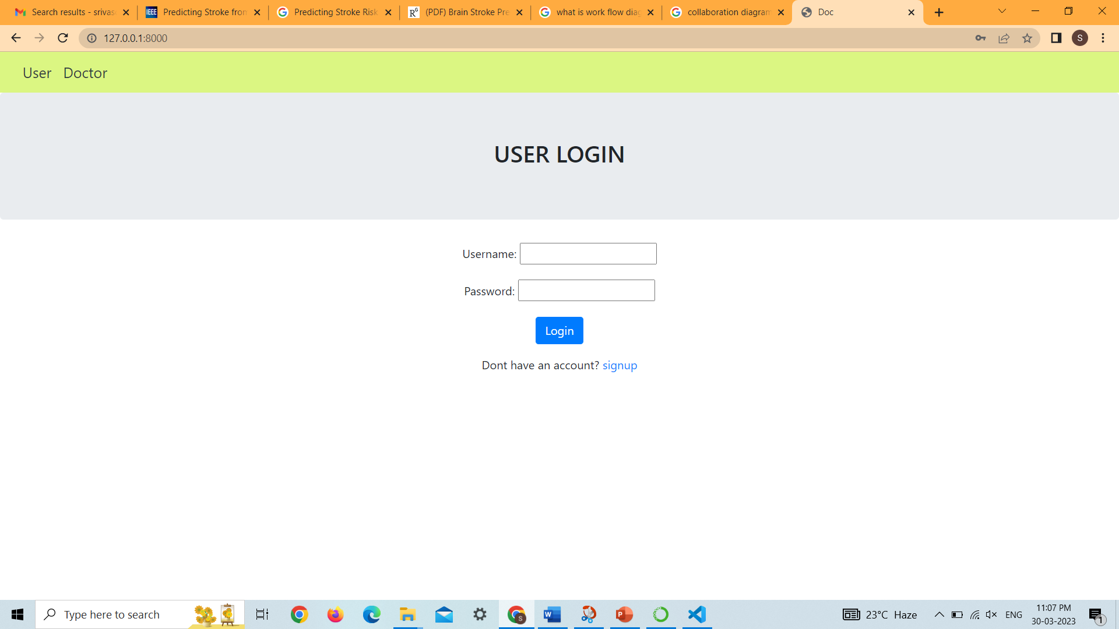
OUTPUT SCREENSHOTS

Slide 18
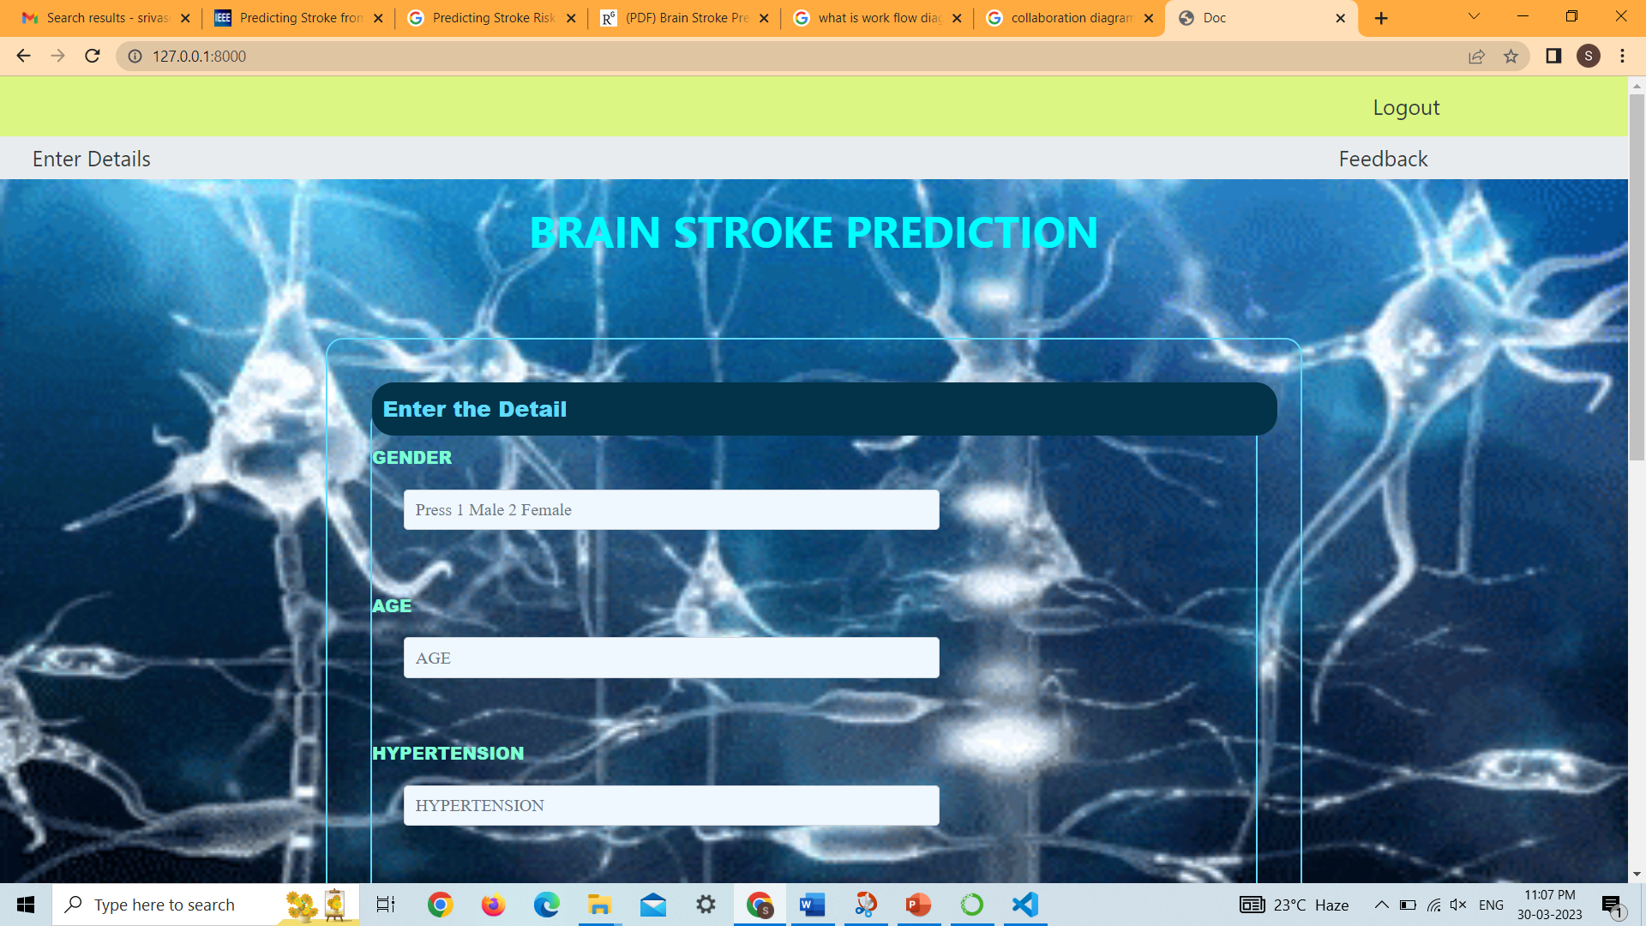

Slide 19
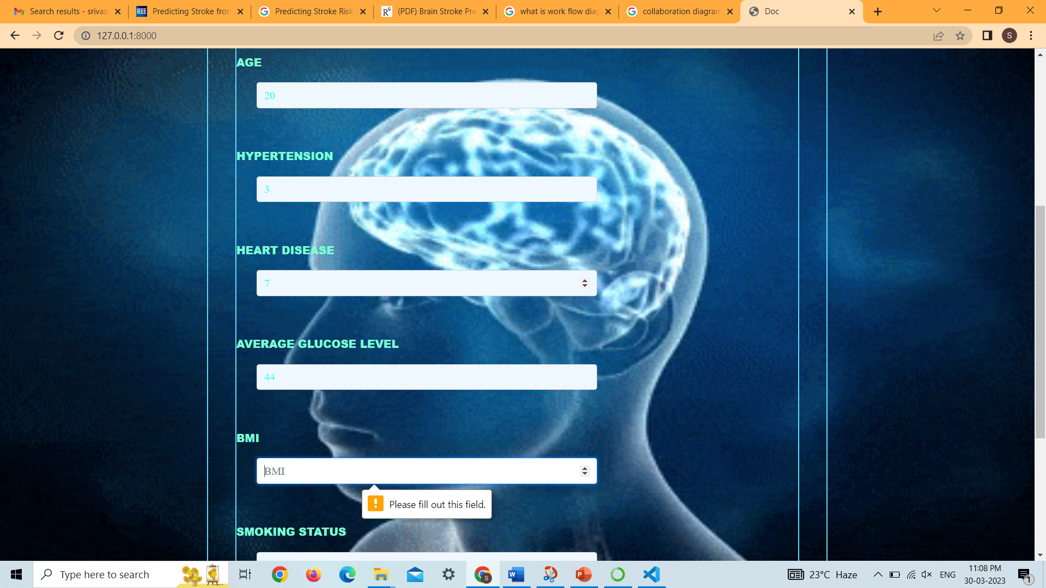

Slide 20
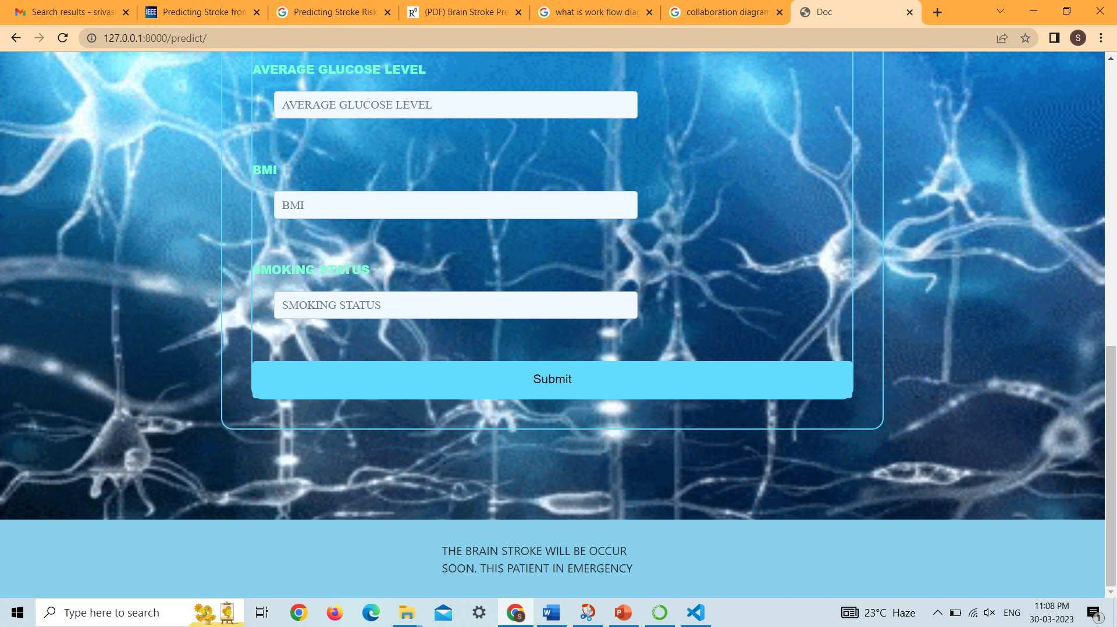

Slide 21
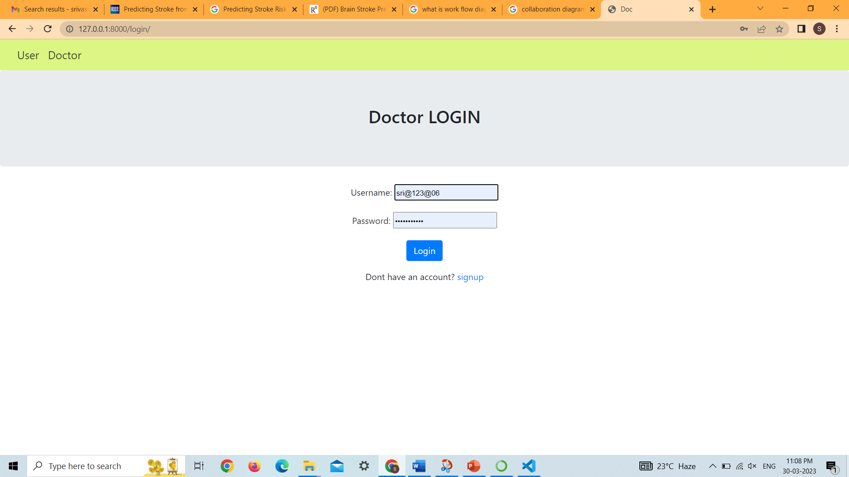

Slide 22
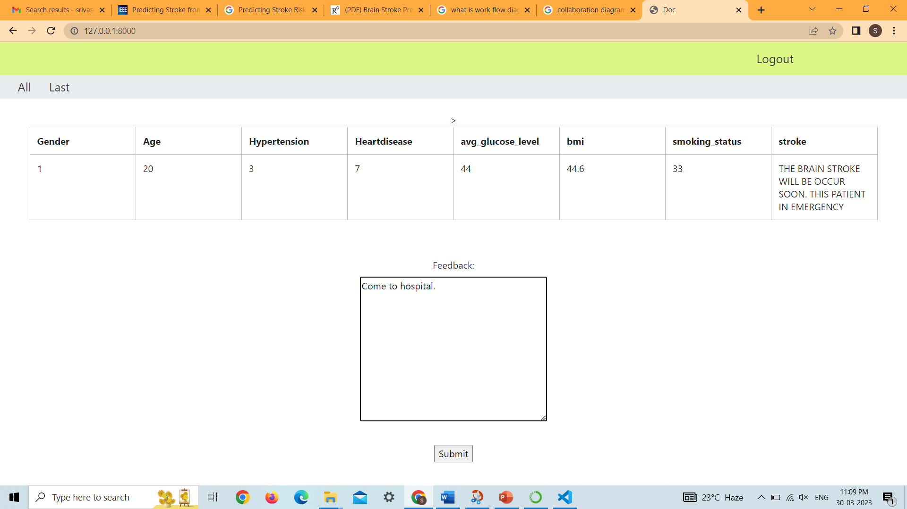

Slide 23
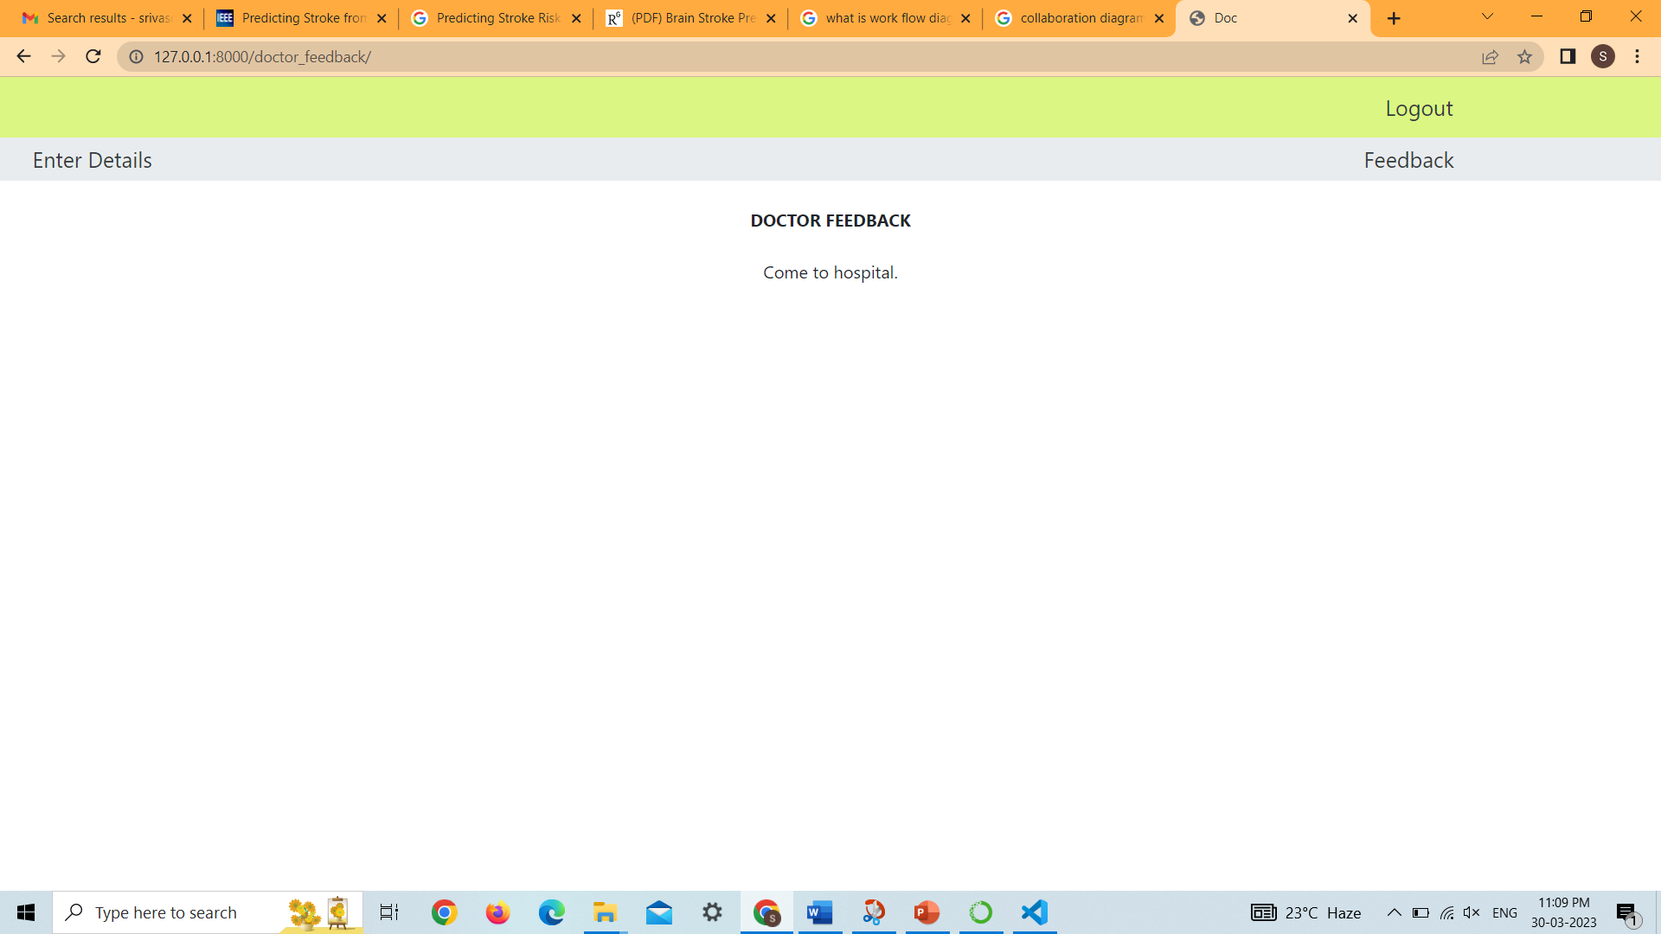

Slide 24
CONCLUSION
After the literature survey, we came to know various pros and cons of
different research papers and thus, proposed a system that helps to predict
brain strokes in a cost effective and efficient way by taking few inputs from
the user side and predicting accurate results with the help of trained
Machine Learning algorithms. Thus, the Brain Stroke Prediction system
implemented using the Machine Learning algorithm has given a Best accuracy
The system is therefore designed for providing simple yet efficient User Interface
design with an empathetic approach towards their users and patients.

Slide 25
REFERENCES
“Concept of stroke by healthline,” Available: https://www.cdc.gov/stroke/index.htm.
S. Y. Adam, A. Yousif, and M. B. Bashir, “Classification of ischemic stroke using machine learning algorithms,” International Journal of Computer Application, vol. 149, no. 10, pp. 26–31, 2016.
P. Govindarajan, R. K. Soundarapandian, A. H. Gandomi, R. Patan, P. Jayaraman, and R. Manikandan, “Classification of stroke disease using machine learning algorithms,” Neural Computing & Applications, vol. 32, no. 3, pp. 817–828, 2020.
L. Amini, R. Azarpazhouh, M. T. Farzadfar et al., “Prediction and control of stroke by data mining,” International Journal of Preventive Medicine, vol. 4, no. 2, pp. S245–S249, 2013.
“Documentation for decision tree classification from scikit-learn,”
G. Sailasya and G. L. A. Kumari, “Analyzing the performance of stroke prediction using ML classification algorithms,” International Journal Of Advanced Computer Science And Applications, vol. 12, no. 6, pp. 539–545, 2021.

